Slide 1
Lofi Prototypes
Crusher

Slide 2
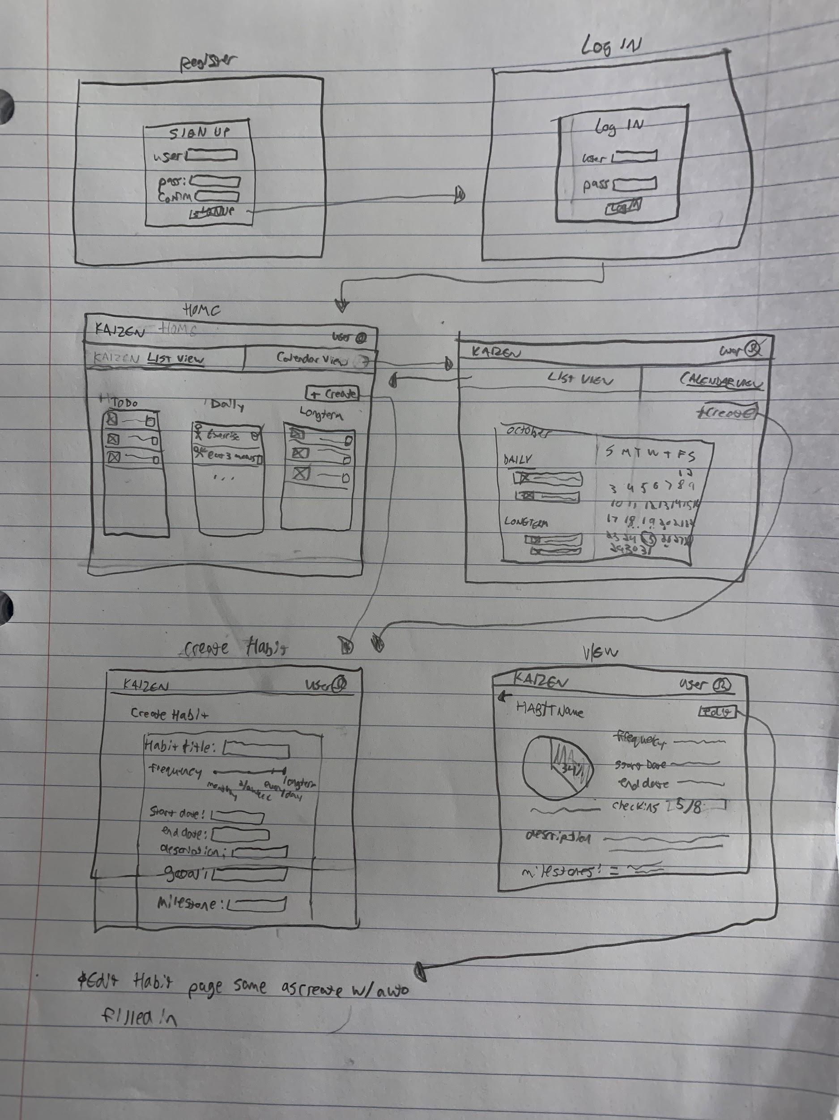
Brandon H’s lofi

Slide 3

Dillan Lo-Fi

Slide 4
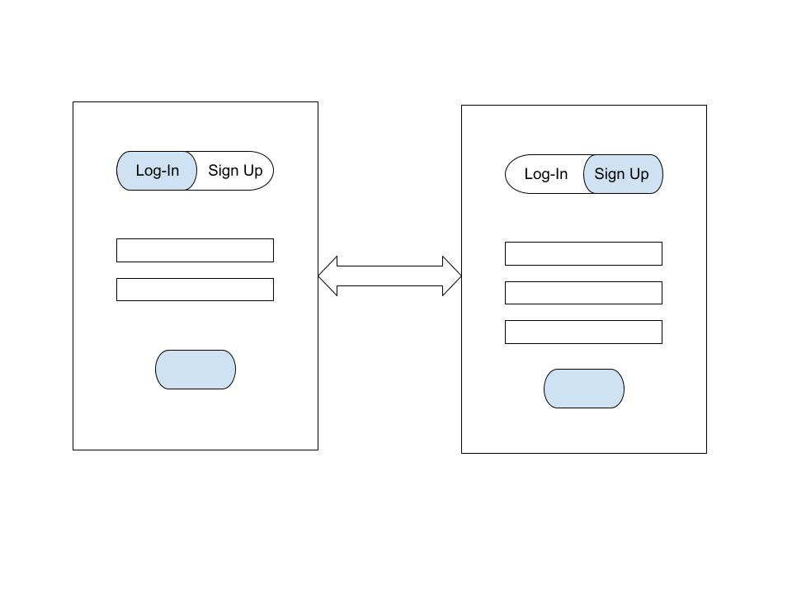
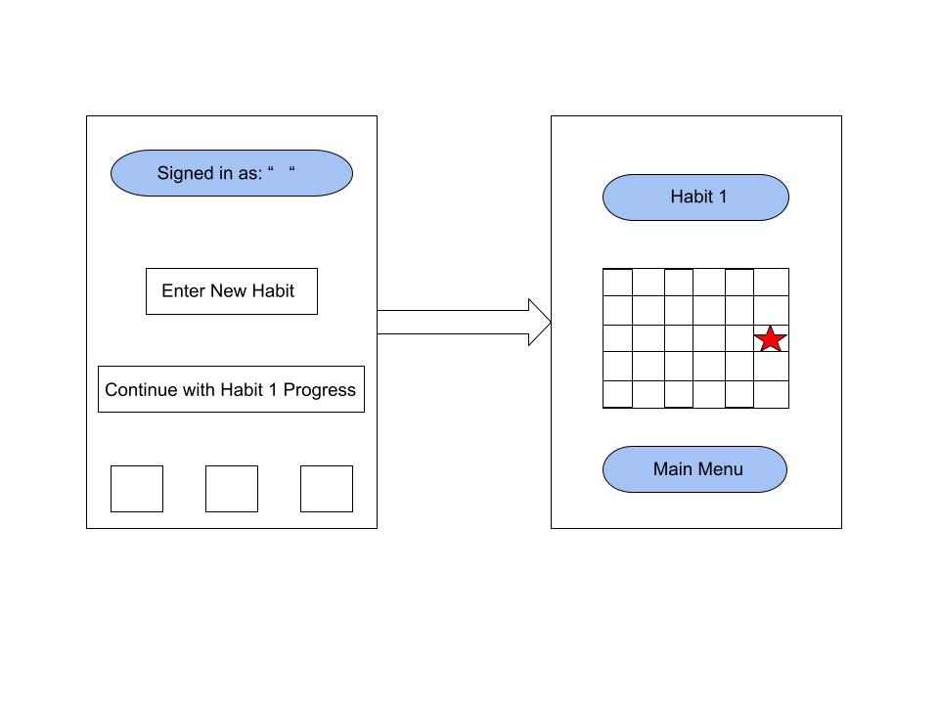
Brandon M’s Lo-Fi

Slide 5
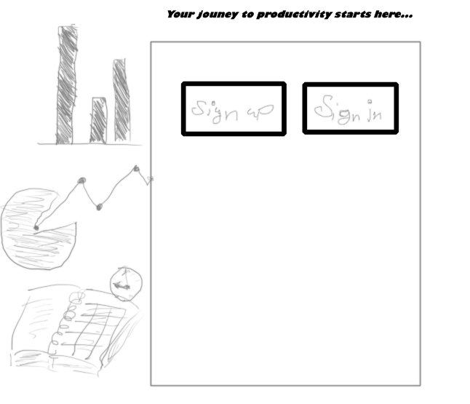

Slide 6
